Slide 1
Calendar of Activities
World Hospice Week Celebration
“Leave No One Behind – Equity in Access to Palliative Care”
October 4-9, 2021

Slide 2
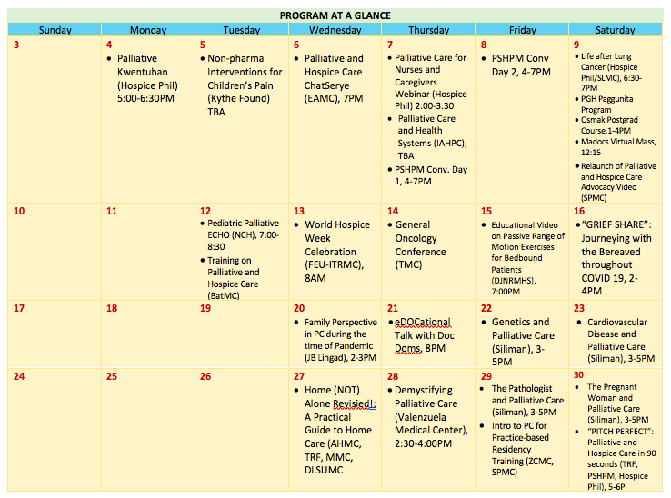

Slide 3
October 4
Hospice Philippines

Slide 4
October 5
“Non-pharmacological Interventions for Children’s Pain”
Kythe Foundation
Webinar link: KYTHE FOUNDATION ZOOM

Slide 5
October 5
Hospice Philippines in collaboration with
Palliative and End of Life Care Association of the Philippines (PEOLCAP),
Activcare Home Health Solutions,
Pain Management Center, SLMC-QC
Speakers:
Vergel Gutana RN
Lou Cagurungan RN
Rose Nuez RN
Link to follow

Slide 6
October 6
Palliative and Hospice Care Chatserye: “Ang bukol na bumago ng buhay namin…”
East Avenue Medical Center Dept of Family and Community Medicine - Palliative Care Services
Webinar via Zoom
7PM
Link to follow

Slide 7
October 7
Palliative Care and Health Systems: A Multistakeholder Dialogue Between Countries at Different Levels of Integration
UN University/International Institute for Global Health (UNU/IIGH) and International Association for Hospice and Palliative Care (IAHPC)
Webinar via Zoom
7PM
Link to follow

Slide 8
October 7-8
Philippine Society of Hospice and Palliative Medicine 3rd Annual Convention (Virtual)

Slide 9
October 9
Life After Lung Cancer Diagnosis: Improving quality of Life thru Palliative Care
Hospice Philippines in the Webinar of Institute of Pulmonary Medicine SLMC-QC entitled C.U.R.E
Speaker: Dr June Michael Razon
Link to follow
6:30-7:00PM

Slide 10
October 9
Paggunita Bereavement Care Program
UP-PGH
Philippine Cancer Society
for invited bereaved family members

Slide 11
October 9
Relauch of Palliative and Hospice Care Advocacy Video
Southern Philippines Medical Center – Section of Palliative and Hospice Care
Via SPMC Facebook Page
10AM

Slide 12
October 9
4th Post Graduate Course of Ospital ng Makati Department of Family and Community Medicine Post Graduate Course in Collaboration with Palliative and Hospice Care Program Committee

Slide 13
October 9
Virtual Mass
Manila Doctors Hospital
12:15PM
Via Zoom thru FB Live

Slide 14
October 12
National Children’s Hospital
(by invitation)

Slide 15
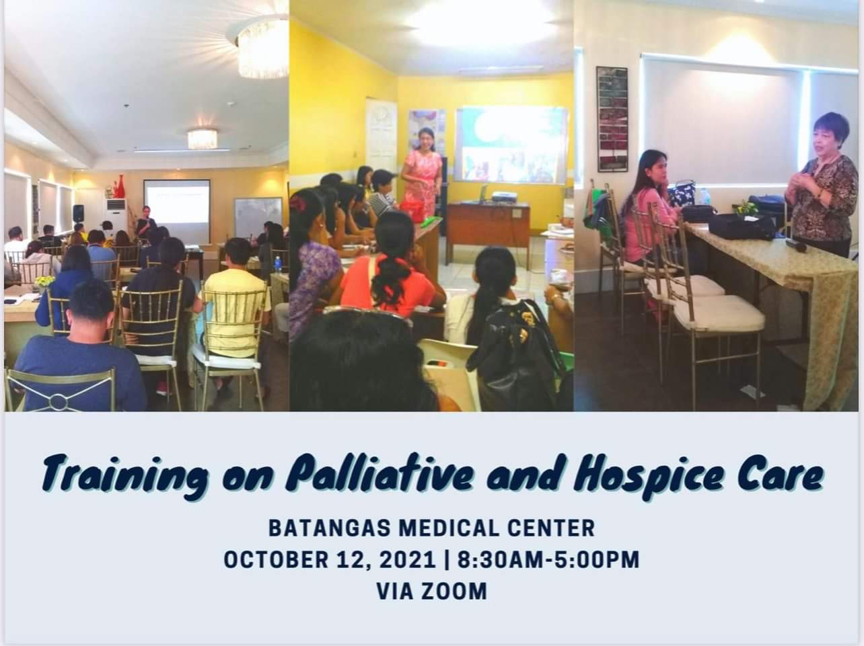
October 12
Batangas Medical Center
(for BatMC Employees only)

Slide 16
October 13
Comfort Focused Care for COVID and Cancer Patients during the Pandemic
(Speaker: Dr Maria Fidelis Manalo)
Via Zoom
How to Communicate Effectively with Patients and Families during the Pandemic
(Speaker: Dr. Barbara Amity Flores)
8:00 AM
Link to follow
Far Eastern University-Dr. Nicanor Reyes Medical Foundation in collaboration with Ilocos Training and Regional Medical Center

Slide 17
October 14
General Oncology Conference on the theme “Leave no one behind”: Improving Access to Palliative Care and Opioid Analgesics”
Via Zoom
The Medical City
Link to follow

Slide 18
October 15
Dr Jose N. Rodriguez Memorial Hospital and Sanitarium Department of Family and Community Medicine

Slide 19
October 16
“GRIEF SHARE”: Journeying with the Bereaved throughout COVID 19
2-4PM
Link to follow
Via Zoom
Stories of Hope amidst Grief
How to prepare for the holidays in the face of the recent loss
The Ruth Foundation

Slide 20
October 20
Jose B Lingad Memorial General Hospital

Slide 21
October 21
Hospice Philippines

Slide 22
October 22, 23, 29 & 30
Day 1: Genetics and Palliative Care
Day 2: Cardiovascular Disease and Palliative Care
Day 3: The Pathologist and Palliative Care
Day 4: The Pregnant Woman and Palliative Care
Link to follow
Siliman University

Slide 23
October 27
Home (NOT) Alone: A Practical Guide to Home Care Management
5:00-6:00 PM
Asian Hospital and Medical Center in collaboration with The Ruth Foundation, Makati Medical Center, De Lasalle Univerity Medical Center
Link to follow
Via Zoom

Slide 24
October 28
Demystifying Palliative Care
2:30-4:00 PM
Valenzuela Medical Center
Link to follow
Via Zoom

Slide 25
October 29
Introduction to Palliative Care for Practice-based Residency Training
Time to be announced
Zamboanga City Medical Center Dept of Family and Community Medicine in collaboration with Southern Philippines Medical Center-Section of Palliative and Hospice Care
Link to follow
Via Zoom

Slide 26
October 30
“PITCH PERFECT”: Palliative and Hospice Care in 90 seconds
5:00-6:00 PM
Elevator pitches on the “what” and “why” of Palliative and Hospice Care from Palliative Specialists and Family of Patients
Link to follow
Via Zoom
The Ruth Foundation
Philippine Society of Hospice and Palliative Medicine
Hospice Philippines

Slide 27
Thank you! ☺

